Slide 1
LIMTECH Alliance
HEMCP:Helmholtz Energy Materials Characterization Platform
Direct energy conversion using liquid metals
Development of a test facility for
Alkali Metal Thermoelectric Converter (AMTEC)
N. Díez de los Ríos, A. Onea, W. Hering, R. Stieglitz, P. Moster
3rd European Energy Conference, Budapest 2013

Slide 2
Contents
Introduction
Alkali Metal Thermoelectric Converter (AMTEC) description
Different direct energy conversion systems
Motivation for the development of AMTEC as topping system of a CSP plant
AMTEC project
Goals and project status
AMTEC TEst FAcility (ATEFA)
Research program
Summary and outlook

Slide 3
AMTEC Description
Heat to electricity converter
Operating principle
Key component: β’’-Alumina Solid Electrolyte (BASE)
Key process: Na-ionization (ΔP across BASE)
Na Na⁺ + e⁻
High T & P - side (anode): P_{Na} ~ 1 ÷ 2 bar; T_{Na} ~ 600 ÷ 1000 °C
Low T & P - side (cathode): P_{Na} < 100 Pa; T_{Na} ~ 200 ÷ 500 °C
Condensed Na
Na return line: EM pump or wick
Devices using electrolyte
Simplified AMTEC process
Solid Oxide Fuel Cell (SOFC)
NaS Battery

Slide 4
Different direct energy conversion systems
Energy Conversion System | T_{min} / T_{max} [°C] | η [%] | Comments
Thermoelectric converter (Seebeck effect) | 100 / 900 | < 20 | Availability of good semiconductors that sustain high temperatures
Thermionic converter | T_{max} > 1500 | < 20 | High operating temperatures
Solar cell | 30 / 60 | 15 - 30 | High costs, “environmentally” expensive, contain toxic elements
Fuel cell | 200 / 1000 | 35 – 60 | Fuel storage, fuel generation and lifetime research needed. High costs.
AMTEC | 200 / 1000 | ~ 20 (40) | Lifetime and efficiency under research
All ECS are under development for being competent in the industry
Issues like lifetime, efficiency, output power and costs need still to be treated
AMTEC - Advantages
High theoretical efficiency (40%)
Flexible regarding the heat source
Suitable for modular design
No moving parts
Silent operation
Flexible connection (to other heat-to-electric systems)
Application for solar energy conversion

Slide 5
Requirements for future solar thermal energy systems
Chemical stability of heat transfer fluid and storage fluid to temperatures up to 700 ° C
Materials with low corrosion problems at high temperatures
Thermal storage for continuous 24/7 operation
Flexible power demand from the storage for the load following capability. Compensation of fluctuating energy supply
High turbine temperature for high efficiency of the Power Conversion System (PCS).
Long operating time to reduce investment costs
Liquid metals as HTF ?
PS10 and PS20 solar tower plants in Sevilla, Spain

Slide 6
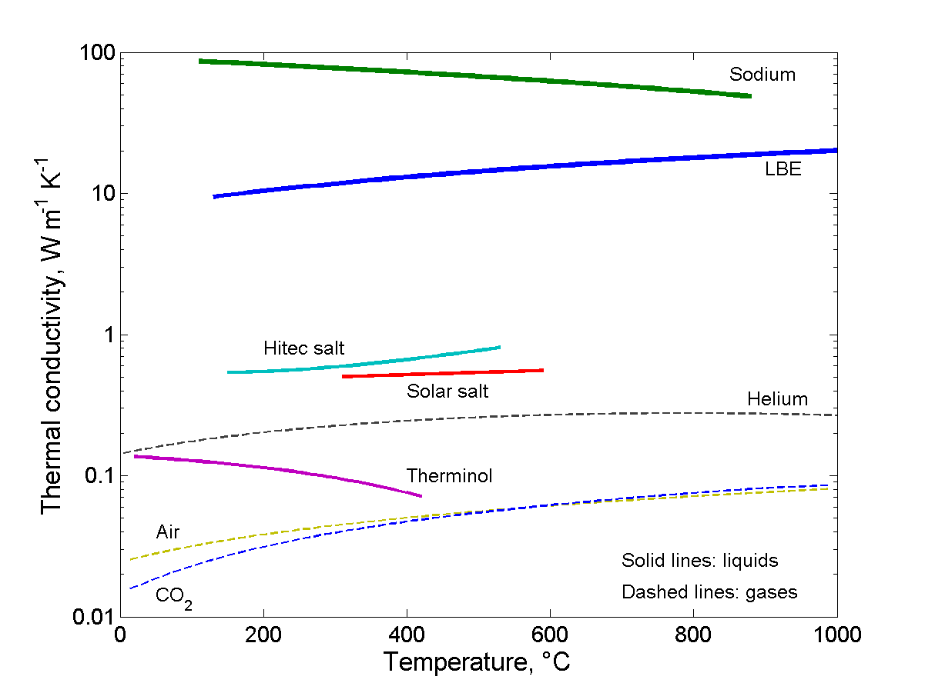
Liquid metals as heat transfer fluid (sodium)
Study of liquid metals as HTF in CSP (Günter, 2012, KIT)
~ 60
Variable | HOT Fluids Specification Target (2nd target) | Therminol VP-1 | Solar Salt (60% NaN03/ 40% KNO3) | Liquid Sodium
Thermal Stability | 800 °C
Thermal Cond. 600 °C | ≥ 0,58 W/mK
Melting Point | ≤ 250 °C
Density 600 °C | ≤ 5400 kg/m³
Advantages of liquid Na
Thermal stability at 880 °C
High thermal conductivity
Relatively low melting point (98 °C)
Low density (810 kg/m³)
Disadvantages of liquid Na
Reactive with air and water
(J.Pacio, 2013)
Safety oriented design and maintenance procedures
Sodium good candidate as a HTF in CSP systems

Slide 7
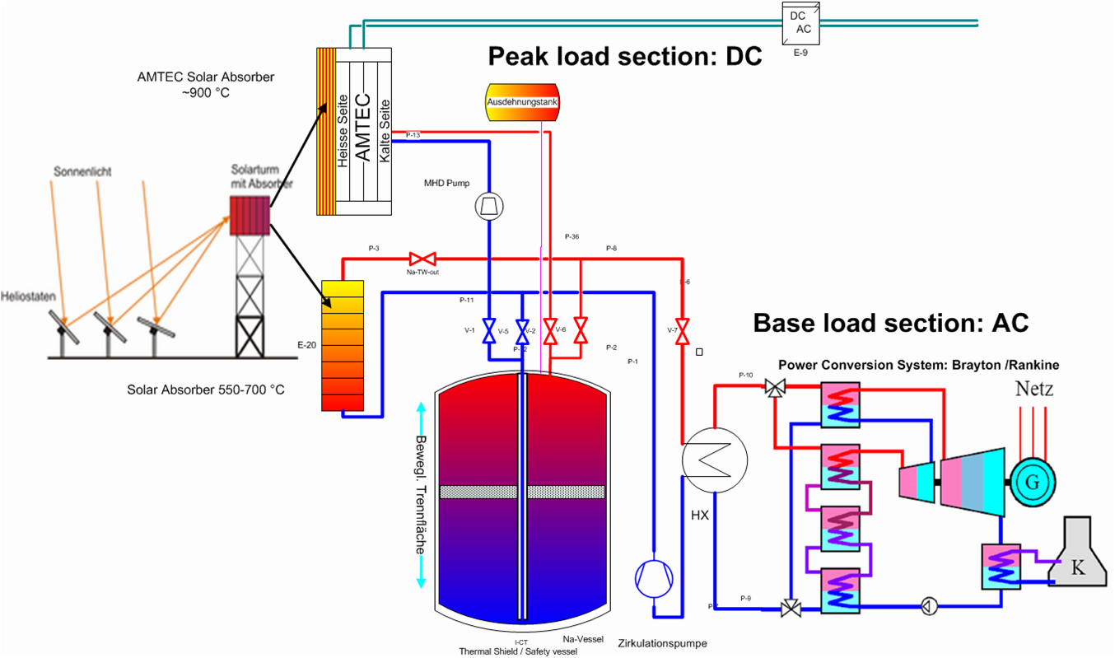
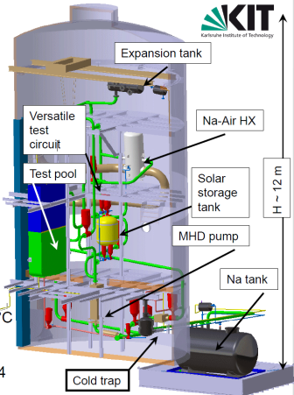
Long term perspective
Hybrid system*: Na - CSP + AMTEC
LIQUID METAL
(Na)
AMTEC
CSP
Solar tower plant
HTF
Storage fluid
Topping system
η* ~ 30 %
CSP - AMTEC hybrid cycle
(*Hering et al., E2C Maastrich, 2012)
Higher efficiency
Longer and more flexible operation
Compensation of the fluctuating energy source
Increase lifetime of PCS
KArlsruhe SOdium Laboratory
(KASOLA)
Prototype for thermal storage
AMTEC prototype
Liquid Na test circuit

Slide 8
Goals AMTEC project (2013-2016)
Fast design and construction of a first prototype
→ Gain know-how and tested technology.
Second prototype
→ Improved technology. Optimized and innovated design..
Industrialization
Design of AMTEC demonstrator & test facility
 |  |  |  |  |  |  | 1st measuring campaign
 |  |  |  |  |  |  |  |  | Optimized design and construction of the 2nd AMTEC demonstrator
 |  |  |  |  |  |  |  |  |  |  |  | 2nd measuring campaign
 |  |  |  |  |  |  |  |  |  |  |  |  | Verification and validation. Industrialization
2013 |  |  |  |  | 2014 |  |  |  |  | 2015 |  |  | 2016
Realization period
Frozen Design
Project status
Concluded first design of AMTEC test cell and test facility
Currently in the construction phase (almost all components were ordered or are in fabrication)

Slide 9
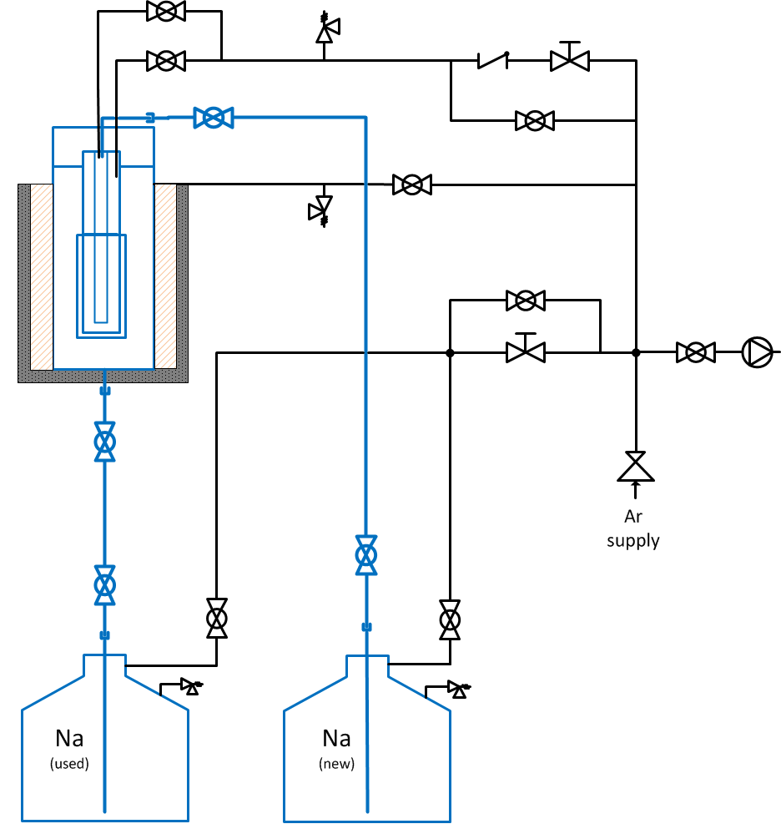
AMTEC TEst FAcility (ATEFA)
Pressure
Controller
Test facility consists of Na-side + Ar-side.
Control Na-flow→ adjustment Ar-pressure and mass flow
Na-side includes:
AMTEC test cell
Condenser → T_{Na} ~ 300 °C
Two storage tanks (Vol ~ 4,5 l)
Ar-side includes:
Pressure controller → ~2 bar
Mass flow controller → Na-mass flow (~ 1 g/min)
Vacuum pump → cleaning of the system from air / water rests
AMTEC
test cell
Vacuum
pump
Condenser
Mass flow
controller
Ar supply
Safe design!
Lessons learned from Almería
In-housed in a metallic box
Na
Ar

Slide 10
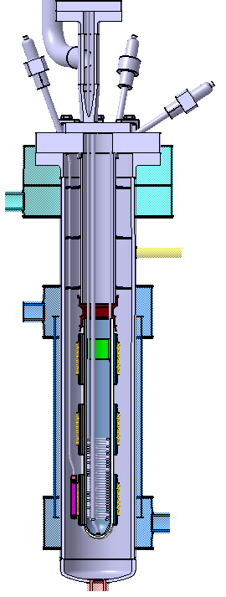
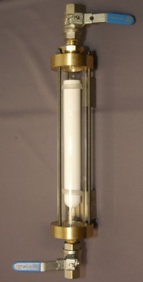
AMTEC test cell
Design based in AMTEC cell from KIT, 1990 – 2001.
Current: 25 – 100 A
Current density: 0.5 – 1.5 A/cm²
Voltage: 0.4 – 1.2 V
Na amount: ~ 0.2 kg
Air cooling of holding
flange (optional)
Thermal stresses
ΔT > 300 °C
BASE – steel joint: Nb
Tests*
Ceramic-metal brazing
Electrodes and current collectors
Ceramic (thickness/ length/ Chem. Stability…)
Corrosion and erosion
*together with other institutes in KIT
AMTEC Cell (KIT 1990)
Condenser
(air cooling)
Na heater
BASE

Slide 11
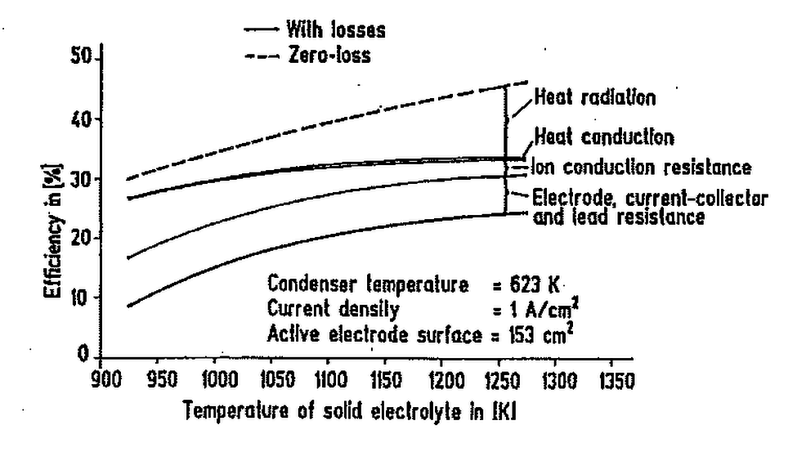
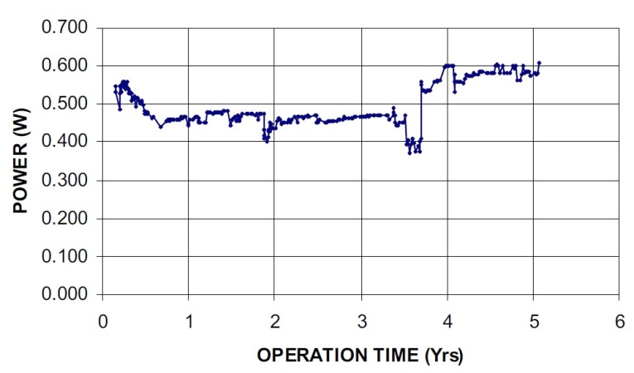
Research program
LIMTECH Project (HGF Alliance on Liquid Metal Technologies)
ATEFA construction → AMTEC demonstrator
Design optimization
Thermal and electrical performance
η_{max} ~ 20 %
Investigation in degradation behavior
Power degradation
Lodhi et al. (2001) →50 % loss (2 years)
BASE degradation ~ 60 %
Electrode degradation ~ 20 %
Hunt et al. (2006) → no power degradation! (5 years)
Construction of advanced liquid-& vapor anode cells.
Heinzel et al.– KIT 1991
HEMCP Project (Helmholtz Material Characterization Platform)
Material characterization (in collaboration with material science, ceramic technology):
BASE-steel interface (Nb)
Steel corrosion / erosion
Electrode composition (Mo, TiN, RhW) and construction
BASE (chemical stability, homogeneity, ionic conductivity)
Hunt and Rasmussen – STAIF 2006

Slide 12
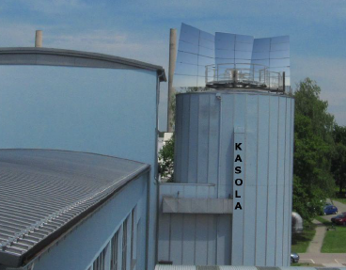
Summary and Outlook
Next step: tested technology of liquid-anode AMTEC and improved technology
Investigation of the performance and power degradation of AMTEC
Study of BASE, electrodes
Feasibility of AMTEC for CSP plants as a topping system

Slide 13
and HEMCP: Helmholtz Energy Materials Characterization Platform
Thank you for your attention
Contact:
nerea.diez@kit.edu
alexandru.onea@kit.edu
wolfgang.hering@kit.edu
Funding:
LIMTEC (Liquid Metal Technology) Alliance → HGF Alliance
HEMCP (Helmholtz Energy Materials Characterization Platform)

Slide 14
Alkali Metal Thermoelectric Converter (AMTEC)
Operating principle
Key component: β’’-Alumina Solid Electrolyte (BASE)
BASE: ~ 85% Al₂O₃, ~10% Na₂O.
Key process: Na-ionization (ΔP across BASE)
High T & P-side (anode):
P_{Na} ~ 1 ÷ 2 bar; T_{Na} ~ 600 ÷ 1000 °C
Na – liquid / vapor
Low T & P-side (cathode):
P_{Na} < 100 Pa; T_{Na} ~ 200 ÷ 500 °C
Condensed Na
Na return line: EM pump or wick
Simplified AMTEC process
Na Na⁺ + e⁻
Notes:
An AMTEC devices converts directly heat into electricity. It’s key component is the beta’’-alumina solid electrolyte (BASE), which is a ceramic known for its large conductivity of Na+ and negligible electronic conductivity. BASE consists mainly of aluminum oxide and Na oxide. BASE separates also high T, high P region from a low T, low P region.
The key process in AMTEC is the ionization of Na, which occurs on the high P side of the BASE surface. By ionization Na molecules are splitted into Na+ and electrons. The pressure difference applied on BASE surface represents the driving force for this process. While Na+ can travel through BASE, the electrons are transported towards an electrical load to generate electricity and then recombine with Na+ on the low P side of BASE to form neutral Na molecules in vapor form. Further Na condensate on a cooled surface of a condenser and then transported back, e.g. with a pump, to the high P side, so that the cycle can restart.

Slide 15
Liquid metals as heat transfer fluids
Variable | HOT Fluids Specification Target (2nd target) | Therminol VP-1 | Solar Salt (60% NaN03/ 40% KNO3) | Liquid metals (General) | Liquid Sodium
Thermal Stability | 800 °C | 400 °C | ~ 600 °C | 800-2600 °C | 883 °C
Thermal Cond. 300 °C 600 °C | ≥ 0,51 W/mK ≥ 0,58 W/mK | 0.0956 W/mK - | ≥ 0,51 W/mK ≥ 0,58 W/mK | > 70 W/mK > 15 W/mK | 75 W/mK 60 W/mK
Melting Point | ≤ 250 °C | 12 °C | 228 °C | < 0-300 °C | 98 °C
Density 300 °C 600 °C | ≤ 6000 kg/m³ ≤ 5400 kg/m³ | 812 kg/m³ 696 kg/m³ | 2084 kg/m³ 1867 kg/m³ | 500 kg/m³ - - 10000 kg/m³ | 880 kg/m³ 810 kg/m³
Vapor Pressure | ≤ 1 bar | 10.7 bar | ≤ 1 bar | << 1 bar | << 1 bar
Viscosity 300 °C 600 °C | ≤ 12 mPas ≤ 4 mPas | 0,217mPas - | 3 mPas 1 mPas | 0,15 mPas 1,5 mPas | 0,33 mPas 0,21 mPas
Heat Capacity | ≥ 1,5 kJ/kgK | ~ 2,5 kJ/kgK | 1,5 kJ/kgK | 0,15 - 4,16 kJ/kgK | 1,25 kJ/kgK
~ 60
(J.Pacio, 2013)
Advantages of liquid Na
Thermal stability at 880 °C
Relatively low melting point
Low viscosity
Low density
High thermal conductivity
Good heat capacity
Disadvantage of liquid Na
Reactive with air and water
Sodium good candidate as a HTF in CSP systems
Notes:
Talking about the requirements of the heat transfer fluid of a Concentrated Solar Power Plant, three different fluids are represented in this table. Therminol VP-1, Solar Salt, and between the Liquid metals we chose Sodium.
As one can see, the most important advantages of liquid sodium compared to Therminol VP-1 and Solar Salts are the high thermal stability (until 883 °C) and the high thermal conductivity (approximately 60 W/mK for 600 °C). Furthermore, the melting point is considerably lower than the solar Salt.
The only parameter that is lower than desired is the heat capacity.
Some of the disadvantages of liquid sodium are its reactivity with air and water and the corrosion.
All in all, Sodium has the necessary properties for beeing a good candidate as a HTF in concentrated solar power systems.

